Slide 1


TABLEAU CAPSTONE PROJECT
Analysis on SUPERSTORE
DATABASE
Submitted By:
Shreyank Purohit

Slide 2
What I have done in project?
Analysis on the data of superstore.
Solved different problem statements.
Made Dashboard.
Made story.
Data was collected from Kaggel.

Slide 3
OBJECTIEVES OF THE PROJECT
To get the knowledge about profit, sales and quantity sold by the store.
To know which category and sub-category is providing maximum sales and profit per year.
To get the information about future sales and profit of the store.
To collect information that which state have maximum sales so that inventory required is sufficient.

Slide 4
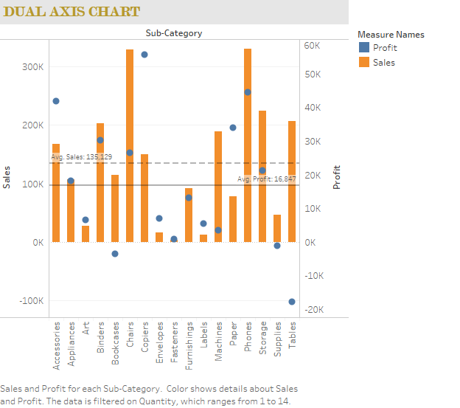
Sales and Profit of the store

Slide 5
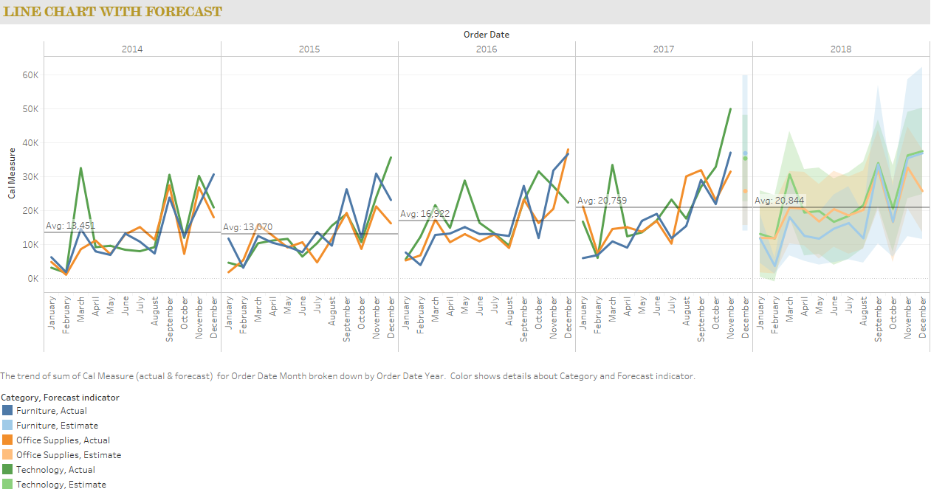
Future sales Forecast of the store

Slide 6
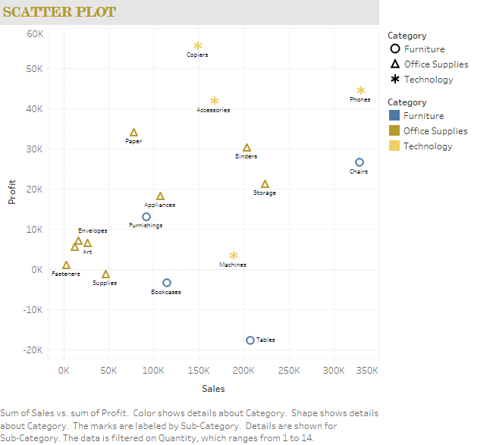
Sub-Categories giving maximum profit and loss

Slide 7
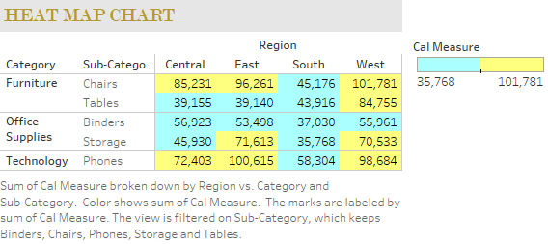
Top 5 sales (Region wise)

Slide 8
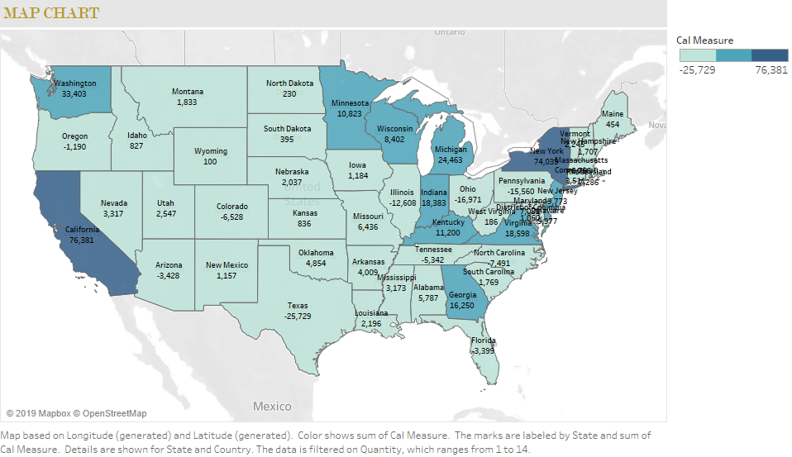
States with maximum profit

Slide 9
Some conclusions and points
Sales of tables is causing impactful loss for the superstore.
The average sales forecast of the superstore remains nearly constant.
Sales of copiers is causing huge hike in average profit for the store.
Most of the sales and profit are in New York and California state.

Slide 10


